Slide 1




High Performance
NoSQL Database
Principles of High Load
Peter Milne
peter@aerospike.com @helipilot50
helipilot50
Powering New
Opportunities at Scale

Slide 2

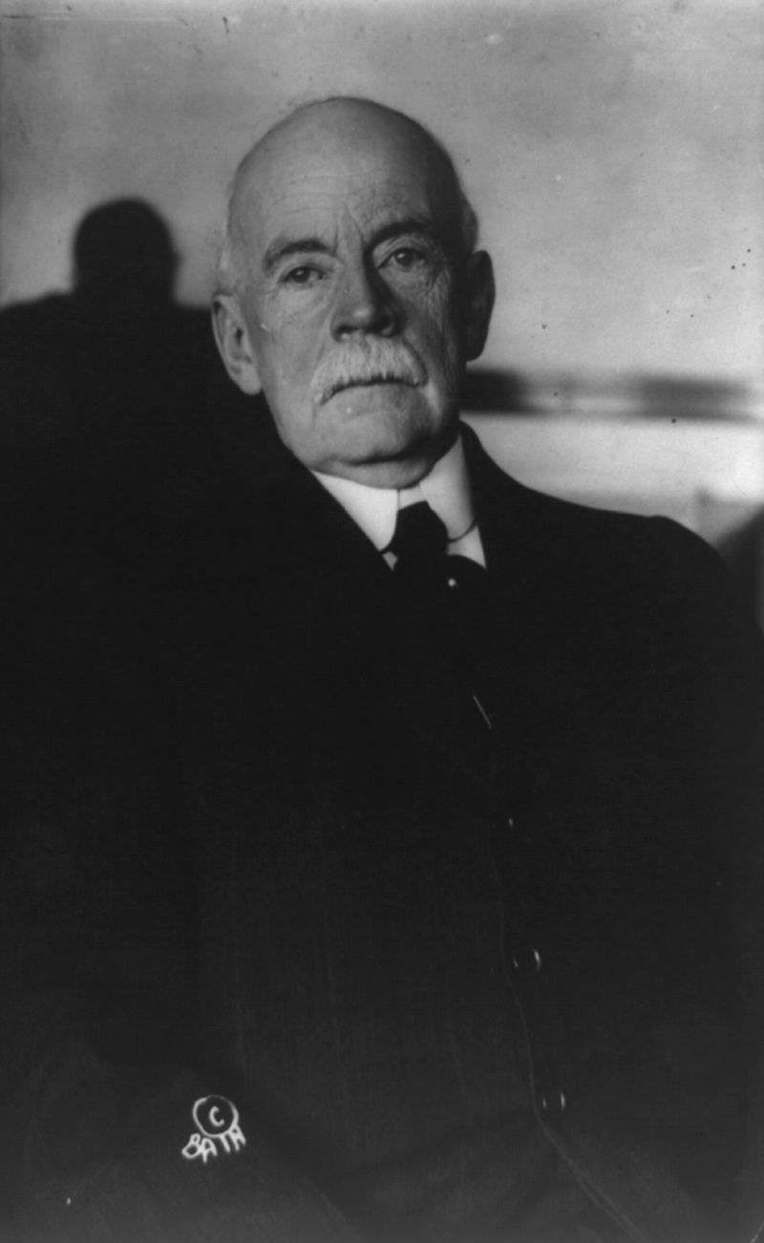
Wisdom vs Guessing
“Insanity is doing the same thing over & over again expecting different results” – Albert Einstein
"Everything that can be invented has been invented.” - Charles Holland Duell – US Patent Office 1899

Slide 3


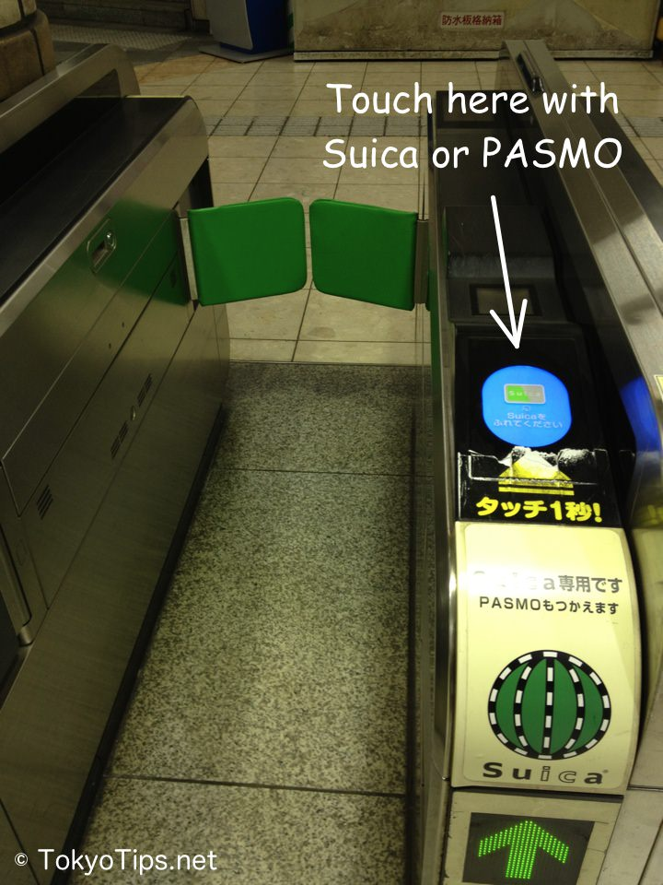
High load
Shinagawa Railway Station – Tokyo, Japan
12 December 2014 08:22 AM
Notes:
The video is 10 sec – how many people did you see?
Each one used a Suica (smart) card.
One of many gates

Slide 4
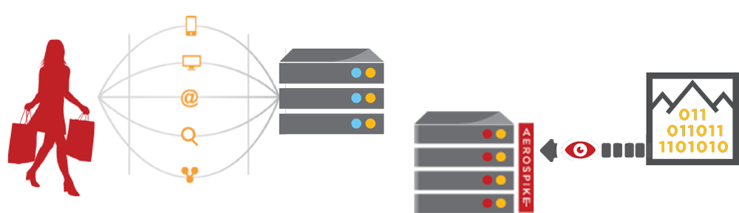



Advertising Technology Stack
APP SERVERS
WRITE CONTEXT
DATA
WAREHOUSE
INSIGHTS
BATCH ANALYTICS
Discover patterns, segment data: location patterns, audience affinity
MILLIONS OF CONSUMERS
BILLIONS OF DEVICES
In-memory NoSQL
WRITE REAL-TIME CONTEXT
READ RECENT CONTENT
PROFILE STORE
Cookies, email, deviceID, IP address, location, segments, clicks, likes, tweets, search terms...
REAL-TIME ANALYTICS
Best sellers, top scores, trending tweets
Currently about 3.0M / sec in North American
Notes:
This is the technology stack that major advertising technology companies built
To sustain the crushing load of aggregating the clicks and views from so many websites
Individual retailers are now using this same tech stack, for the same reason
They wish to present an experience, and include Analytics-based results

Slide 5



Travel Portal
Travel App
Airlines forced interstate banking
Legacy mainframe technology
Multi-company reservation and pricing
Requirement: 1M TPS allowing overhead
SESSION
MANAGEMENT
PRICING
DATA
Session
Data
Read
Price
Store
Latest
Price
XDR
Poll for
Pricing
Changes
PRICING DATABASE
(RATE LIMITED)
Notes:
( also will discuss retail here! The switch from CATALOG to INTERACTIVE and DEALS – same load! Must touch and track ALL USERS, those are the ones you need to influence, not those with existing affinity and logins )
Travel has long been an innovator in technology.
Long ago, Airlines created some of the first credit card systems and intrastate banking
Later, they pioneered real-time pricing for global seat reservation, but got hung up in technology
They applied massive cache layers, but have consistancy problems. How often do you try to reserve and find the seat is no longer available, or at a different price?
These companies are reaching out for the same internet technologies – with thousands of flights, removing caches, and allowing 100K queries per second, from partners and through open APIs to encourage rich apps.

Slide 6
Financial Services – Intraday Positions
Finance App
Records App
ACCOUNT
POSITIONS
RT Reporting App
REAL-TIME
DATA FEED
Query
Read/Write
XDR
Start of Day
Data Loading
End of Day
Reconciliation
10M+ user records
Primary key access
1M+ TPS
LEGACY DATABASE
(MAINFRAME)
Notes:
Advertising was one of the pioneers, now other enterprises are understanding the need
For this architecture.
The traditional software & hardware providers scoff at these requirements and speed, but
Cutting edge companies now understand that the technology is available, and are finding uses
In their interprises.
We are working with several financial services companies on providing an Intraday Positions
Database. Instead of a cache / relational architecture, the requirement is around 1M TPS
Velocity driven by:
Faster trading
Mobile customers
Recommendations

Slide 7
QOS & Real-Time Billing for Telcos
In-switch Per HTTP request Billing
US Telcos: 200M subscribers, 50 metros
In-memory use case
SOURCE
DEVICE/ USER
Request
Execute Request
Real-time Auth. QoS Billing
DESTINATION
Real-time
Checks
Config Module App
Update
Device
User
Settings
Hot Standby
XDR
Notes:
A new use case is happening with telecom and network providers.
In order to provide rich network routing decisions, network operators are experimenting with a new form of Quality of service.
These quality of service levels are driven by the CONTENT of HTTP interactions, using deep packet inspection.
Use is also over 100K TPS, and requires ALWAYS UP database availability, just like the initial advertising users

Slide 8
Principles

Slide 9
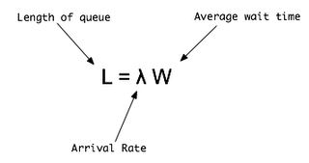

Little's Law
The long-term average number of customers L in a stable system is equal to the long-term average effective arrival rate λ, multiplied by the average time W a customer spends in the system
λ
λ
ρ
W
S
R

Slide 10
Queuing Theory
Queuing theory is the mathematical study of waiting lines, or queues.
Average Wait in Queue (Wq)
Service
Rate (μ)
Average Number in Queue (Lq)
Arrival Rate (λ)
Departure
Average Time in System (W)
Average Number in System (L)

Slide 11

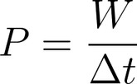
Throughput
Throughput is the rate of production or the rate at which something can be processed
Similar to Power: “work done / time taken” The power of a system is proportional to its throughput

Slide 12
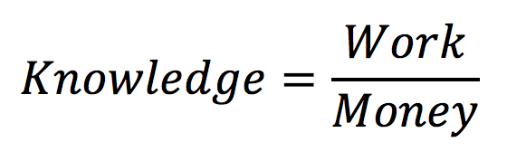
Throughput
Throughput is the rate of production or the rate at which something can be processed
Similar to Power: “work done / time taken” The power of a system is proportional to its throughput

Slide 13
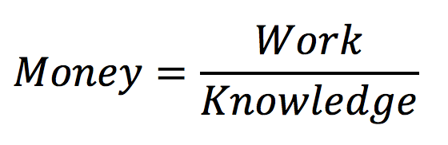
Throughput
Throughput is the rate of production or the rate at which something can be processed
Similar to Power: “work done / time taken” The power of a system is proportional to its throughput

Slide 14
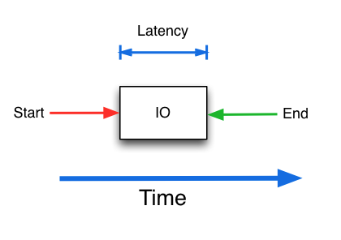
Latency
Latency is a time interval between the stimulation and response, or, from a more general point of view, as a time delay between the cause and the effect of some physical change in the system being observed.

Slide 15




Concurrency
Concurrency is a property of systems in which several computations are executing simultaneously, and potentially interacting with each other.
Shared resource

Slide 16
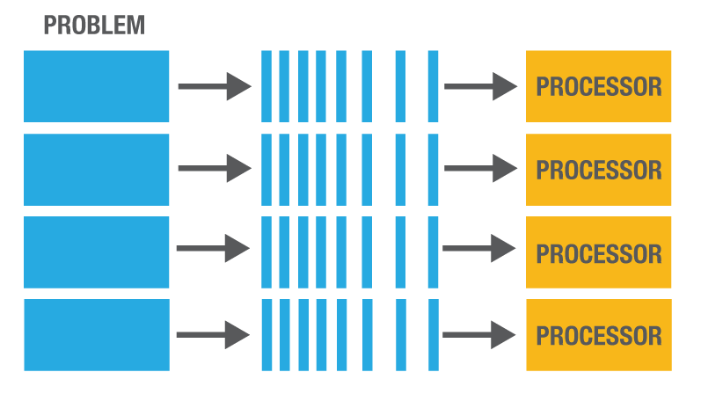
Division of labor – Parallel processing
Parallel processing is the simultaneous use of more than one CPU or processor core to execute a program or multiple computational threads. Ideally, parallel processing makes programs run faster because there are more engines (CPUs or cores) running it. In practice, it is often difficult to divide a program in such a way that separate CPUs or cores can execute different portions without interfering with each other.

Slide 17
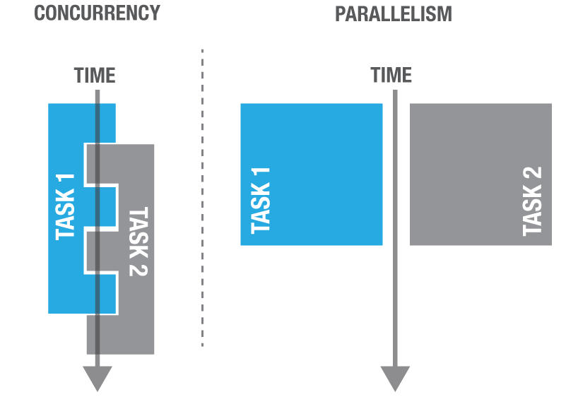
Concurrency vs Parallelism

Slide 18
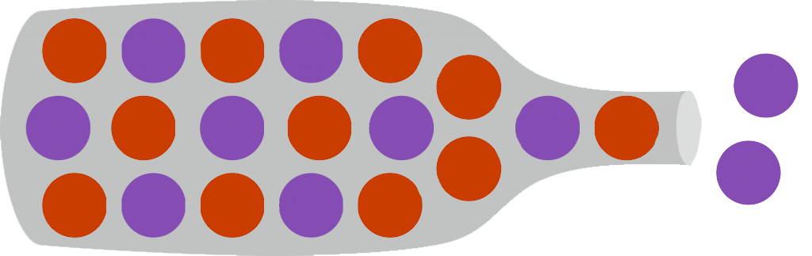
Bottle necks
Bottleneck is a phenomenon where the performance or capacity of an entire system is limited by a single or small number of components or resources

Slide 19
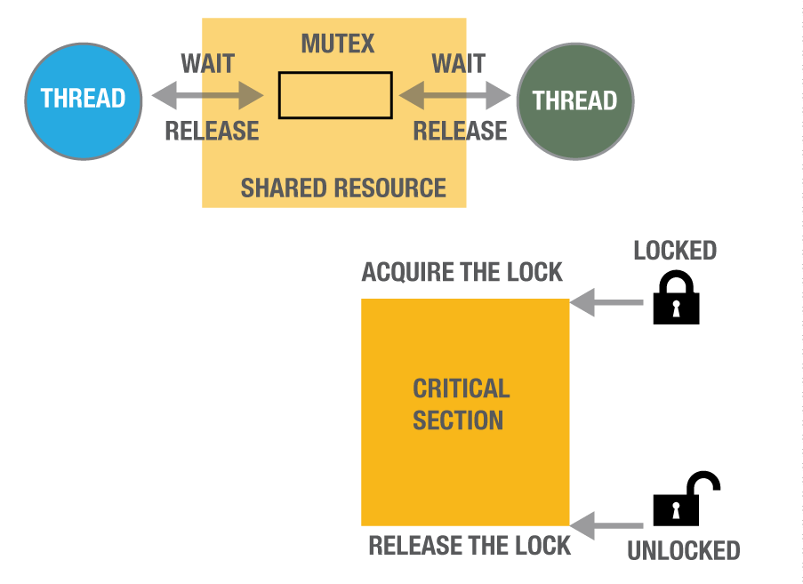
Locks, Mutexes and Critical Regions
Lock
Atomic Latch
Hardware implementation
1 machine instruction
OS system routine
Mutex
Mutual exclusion
Combination of a Lock and a Semaphore
Critical section
Region of code allowing 1 thread only.
Bounded by Lock/Mutex

Slide 20
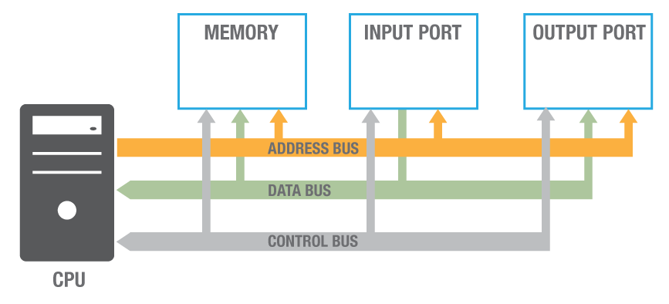
Basic computer architecture

Slide 21
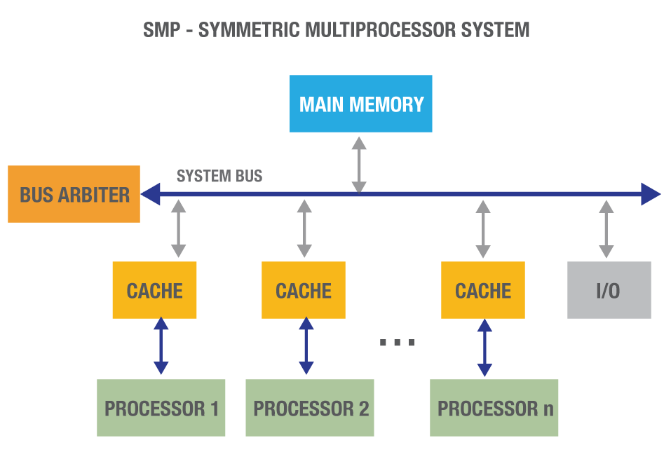
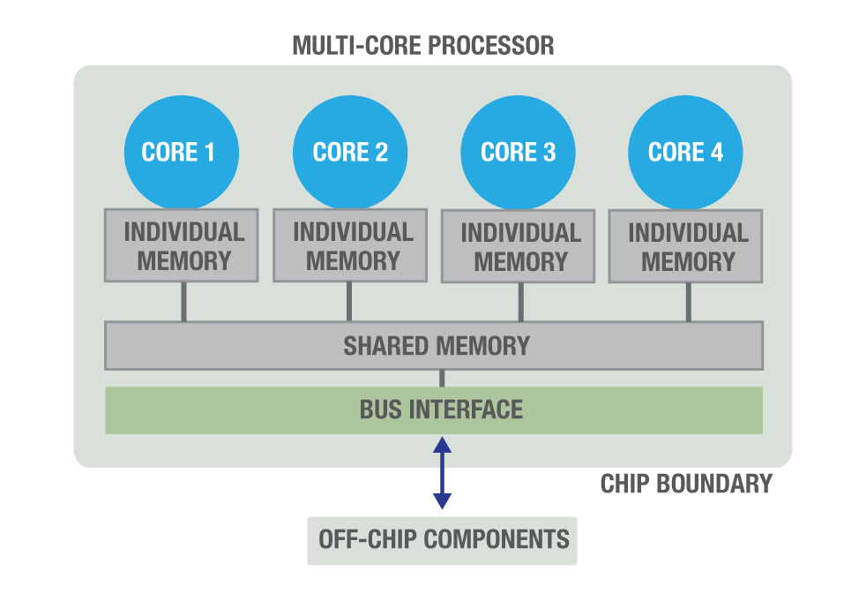
Multi-processor, Multi-core, NUMA
Multi-processor
> 1 processor sharing Bus and Memory
Multi-core
> 1 processor in a chip
Each with local Memory
Access to shared memory
Non Uniform Memory Allocation
Local memory faster to access than shared memory
Multi-channel Bus

Slide 22
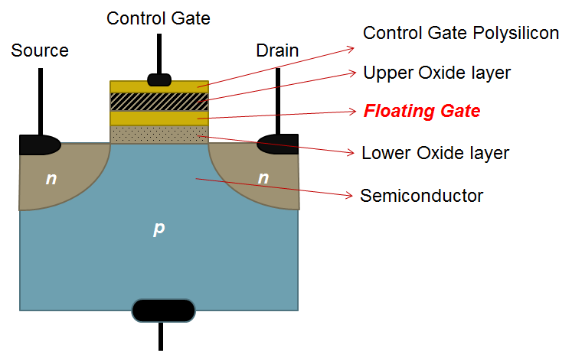
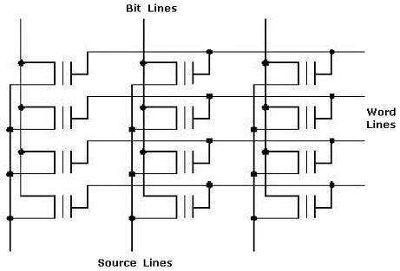
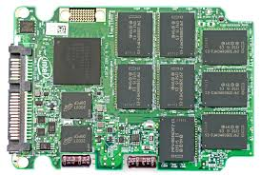
Flash - SSDs
Uses Floating Gate MOSFET
Arranged into circuits “similar” to RAM
Packaged as PCIe or SATA devices
No seek or rotational latencies

Slide 23
How Aerospike does it

Slide 24
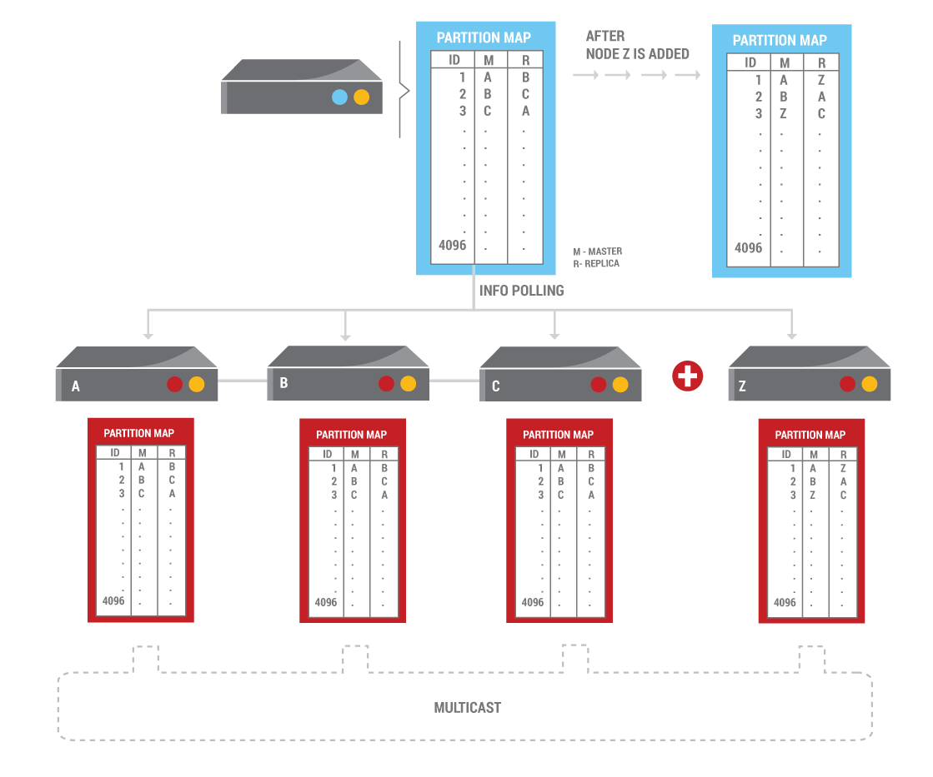
Distributed Hash table
Distributed Hash Table with No Hotspots
Every key hashed with RIPEMD160 into an ultra efficient 20 byte (fixed length) string
Hash + additional (fixed 64 bytes) data forms index entry in RAM
Some bits from hash value are used to calculate the Partition ID (4096 partitions)
Partition ID maps to Node ID in the cluster
1 Hop to data
Smart Client simply calculates Partition ID to determine Node ID
No Load Balancers required
Notes:
From Key to Node
Aerospike has a shared nothing architecture, all nodes in a cluster are identical and there is no single point of failure. The cluster scales elastically and linearly as nodes are added or removed.
Data distributed evenly across nodes using RIPEMD160
Distribution algorithm minimizes data movement when nodes come or go and cluster must be re-balanced. Proprietary paxos based consensus algorithm auto-discovers and efficiently manages cluster formation .
Read/writes continue non-stop during cluster re-organization.
Self-healing architecture includes auto-discovery of cluster changes, auto-failover, auto-rebalancing, background backups/restores and rolling upgrades ensure zero touch and zero downtime operations.
Only manual intervention required is for physical changes to cluster e.g. adding or upgrading hardware.

Slide 25
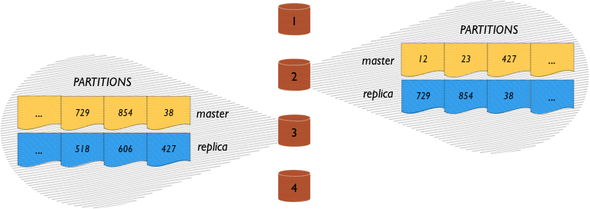
Data Distribution
Data is distributed evenly across nodes in a cluster using the Aerospike Smart Partitions™ algorithm.
RIPEMD160 (no collisions yet found)
4096 Data Partitions
Even distribution of
Partitions across nodes
Records across Partitions
Data across Flash devices
Primary and Replica Partitions
Notes:
Data Distribution
Aerospike Database has a Shared-Nothing architecture: every node in an Aerospike cluster is identical, all nodes are peers and there is no single point of failure.
Data is distributed evenly across nodes in a cluster using the Aerospike Smart Partitions™ algorithm. This algorithm uses an extremely random hash function that ensures that partitions are distributed very evenly within a 1-2% error margin.
To determine where a record should go, the record key (of any size) is hashed into a 20-byte fixed length string using RIPEMD160, and the first 12 bits form a partition ID which determines which of the partitions should contain this record. The partitions are distributed equally among the nodes in the cluster, so if there are N nodes in the cluster, each node stores approximately 1/N of the data.
Because data is distributed evenly (and randomly) across nodes, there are no hot spots or bottlenecks where one node handles significantly more requests than another node. The random assignment of data ensures that server load is balanced.
For reliability, Aerospike replicates partitions on one or more nodes. One node becomes the data master for reads and writes for a partition and other nodes store replicas.
Synchronous replication ensures immediate consistency and no loss of data. A write transaction is propagated to all replicas before committing the data and returning the result to the client. In rare cases during cluster re-configurations when the Aerospike Smart Client™ may have sent the request to the wrong node because it is briefly out of date, the Aerospike Smart Cluster™ transparently proxy's the request to the right node. Finally, when a cluster is recovering from being partitioned, it resolves any conflicts that may have occurred between different copies of data. Resolution can be configured to be automatic, in which case the data with the latest timestamp is canonical or both copies of the data can be returned to the application for resolution at that higher level.

Slide 26

Consistency
Tunable consistency – Default: Immediate Consistency
Write sent to row master
Latch against simultaneous writes
Apply write to master memory and replica memory synchronously
Queue operations to storage
Signal completed transaction (optional storage commit wait)
Master applies conflict resolution policy (rollback/ rollforward)
master
replica

Slide 27


Automatic rebalancing
Adding, or Removing a node, the Cluster automatically rebalances
Cluster discovers new node via gossip protocol
Paxos vote determines new data organization
Partition migrations scheduled
When a partition migration starts, write journal starts on destination
Partition moves atomically
Journal is applied and source data deleted
After migration is complete, the Cluster is evenly balanced.
Notes:
A node is added to the cluster
When a node is added to the cluster, to provide increases capacity or throughput, the existing nodes use the heartbeat to locate the new node. The cluster then begins the process of data migration so that the new node becomes data master for some partitions and replica for other partitions. The client also detects these changes automatically and future requests are sent to the correct node.
What happens when a node is removed?
If a node has a hardware failure or it is being upgraded the inverse happens. On a 4 node cluster 1 node is the data master for about 1/4 of the data and those partitions now exist only on the replicas on nodes. The remaining nodes automatically perform data migration to copy the replica partitions to new data masters.
At the same time, your application, through the Smart Client™ becomes aware that the node has failed and the client automatically calculates the new partition map.
Automatic rebalancing
The data rebalancing mechanism (ensures that query volume is distributed evenly across all nodes, and is robust in the event of node failure happening during rebalancing itself. The system is designed to be continuously available, so data rebalancing doesn't impact cluster behavior. The transaction algorithms are integrated with the data distribution system, and there is only one consensus vote to coordinate a cluster change. With only one vote, there is only a short period when the cluster internal redirection mechanisms are used while clients discover the new cluster configuration. Thus, this mechanism optimizes transactional simplicity in a scalable shared-nothing environment while maintaining ACID characteristics.
By not requiring operator intervention, the cluster will self-heal even at demanding times. The capacity planning and system monitoring provide you the ability to handle virtually any unforeseen failure with no loss of service. You can configure and provision your hardware capacity and set up replication/synchronization policies so that the database recovers from failures without affecting users.
Data migration can be tuned to meet your operational requirements see http://www.aerospike.com/docs/operations/tune/migration/

Slide 28
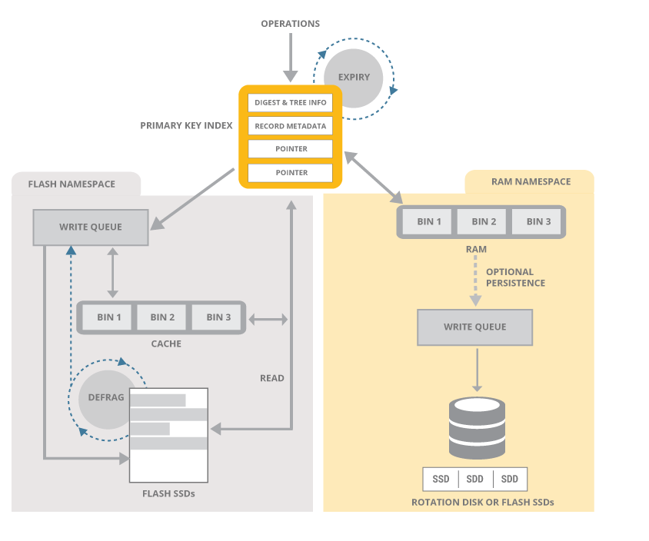
Data Storage Layer
Notes:
Data Storage Layer
Aerospike is a key-value store with schema-less data model. Data is organized into policy containers called namespaces, semantically similar to databases in an RDBMS system. Within a namespace, data is subdivided into sets (similar to tables) and records (similar to rows). Each record has an indexed key that is unique in the set, and one or more named bins (similar to columns) that hold values associated with the record.
Sets and bins do not need to be defined up front, but can be added during run-time for maximum flexibility.
Values in bins are strongly typed, and can include any of supported data-types. Bins themselves are not typed, so different records could have the same bin with values of different types.
Indexes ( primary keys and secondary keys ) are stored in RAM for ultra-fast access and values can be stored either in RAM or more cost-effectively on SSDs. Each namespace can be configured separately, so small namespaces can take advantage of DRAM and larger ones gain the cost benefits of SSDs.
The Data Layer was particularly designed for speed and a dramatic reduction in hardware costs. It can operate all in-memory, eliminating the need for a caching layer or it can take advantage of unique optimizations for flash storage. In either case, data is never lost.
100 Million keys take up only 6.4GB. Although keys have no size limitations, each key is efficiently stored in just 64 bytes.
Native, multi-threaded, multi-core Flash I/O and an Aerospike log structured file system take advantage of low level SSD read and write patterns. In addition, writes to disk are performed in large blocks to minimize latency. This mechanism bypasses the standard file system, historically tuned to rotational disks.
Also built-in are a Smart Defragmenter and Intelligent Evictor . These processes work together to ensure that there is space in RAM and that data is never lost and safely written to disk.
The Defragmenter tracks the number of active records in each block and reclaims blocks that fall below a minimum level of use.
The Evictor removes expired records and reclaims memory if the system gets beyond a set high water mark. Expiration times are configured per namespace, the age of a record is calculated from the last time it was modified, the application can override the default lifetime at any time and specify that a record should never be evicted.

Slide 29
Data on Flash / SSD
Record data stored contiguously
1 read per record (multithreaded)
Automatic continuous defragment
Data written in flash optimal blocks
Automatic distribution (no RAID)
Writes cached
AEROSPIKE
HYBRID MEMORY SYSTEM™
BLOCK INTERFACE
SSD
SSD
SSD
Notes:
Hybrid Storage
The Hybrid Memory System holds the indexes and data stored in each node, and handles interactions with the physical storage. It also contains modules that automatically remove old data from the database, and defragment the physical storage to optimize disk usage.
Aerospike can store data in RAM or on Flash (SSD), and each namespace can be configured separately. This configuration flexibility allows an application developer to put a small namespace that is frequently accessed in RAM, but put a larger namespace in less expensive storage such an SSD.
Significant work has been done to optimize data storage on SSDs, including bypassing the file system to take advantage of low-level SSD read and write patterns.
Philosophy
Other than Large Data Types, all the data for a record is stored together. The amount of storage for each row is limited by default to 1 MB in size, which can be increased.
Storage is copy-on-write, with free space being reclaimed by the defragmentation process.
Each namespace is configured with a fixed amount of storage. Each node must have the same namespaces in each server, and the same amount of storage for each namespace.
Storage can be configured with pure RAM without persistence, RAM with storage persistence, or using Flash storage (SSDs).
Eviction based on storage
The Defragmenter tracks the number of active records on each block on disk, and reclaims blocks that fall below a minimum level of use. The Evictor is responsible for removing references to expired records, and for reclaiming memory if the system gets beyond a set high water mark. When configuring a namespace, the administrator specifies the maximum amount of RAM used for that namespace, as well as the default lifetime for data in the namespace. Under normal operation, the Evictor looks for data that has expired, freeing the index in memory and releasing the record on disk. The Evictor also tracks the memory used by the namespace, and releases older, although not necessarily expired, records if the memory exceeds the configured high water mark. By allowing the Evictor to remove old data when the system hits its memory limitations, Aerospike can effectively be used as an LRU cache. Note that the age of a record is measured from the last time it was modified, and that the Application can override the default lifetime any time it writes data to the record. The Application may also tell the system that a particular record should never be automatically evicted.

Slide 30
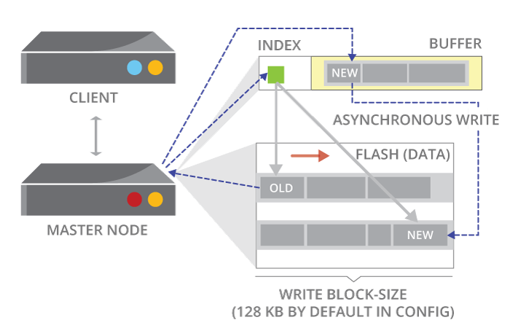
Copy on write – Log structured writes
Record is written to new block
Not written in place
Much faster
Even wearing of Flash

Slide 31
Service threads, Queues, Transaction threads
Flash Storage
TCP/IP Socket
Service Queues
Transaction Threads
Service Threads
Notes:
Transaction thread sends the message back on the File Descriptor
Additional Queues for Scan and Batch, Query → long running Jobs
Memory access – cache miss boundary – one malloc, jemalloc can control the memory arena for long life memory as apposed short lived, controls fragmentation – one network buffer.

Slide 32
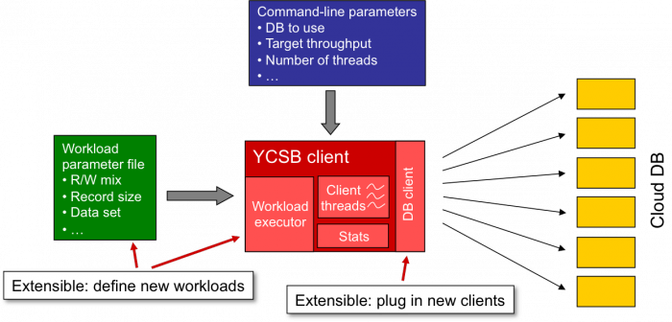

YCSB – Yahoo Cloud Serving Benchmark
Throughput vs Latency

Slide 33
High load failures

Slide 34


Networking – Message size and frequency

Slide 35

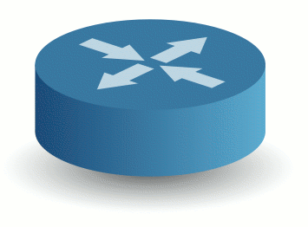
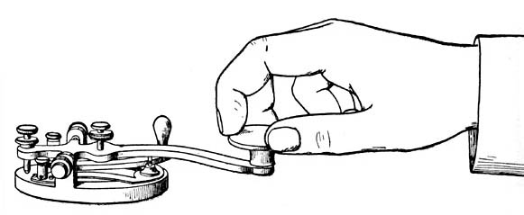
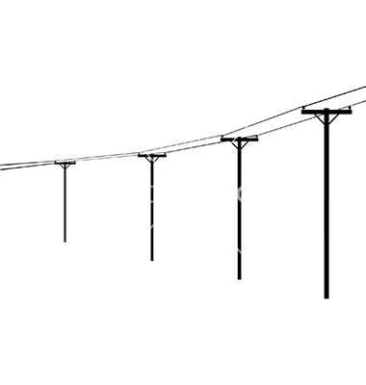
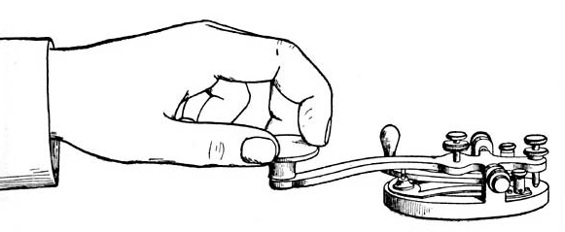
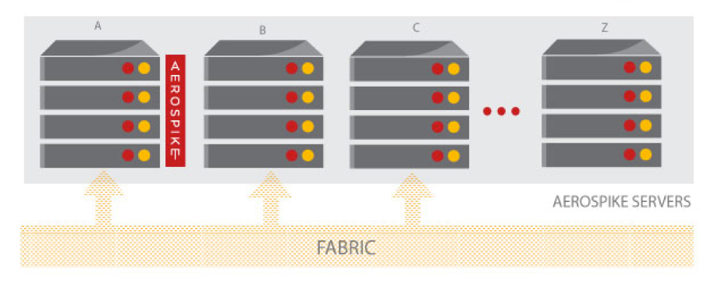
Networking - design

Slide 36
Big Locks
Locks held for too long
Increases latency
Decreases concurrency
Results in a bottleneck

Slide 37
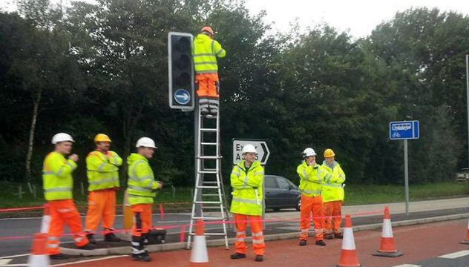
Computing power not used
Network IRQ not balanced across all Cores
1 core does all the I/O
Code does not use multiple cores
Single threaded
1 core does all the processing
Uneven workload on Cores
1 core 90%, others 10%
Code not NUMA aware
Using shared memory

Slide 38


Stupid code
1980’s programmers worried about
Memory, CPU cycles, I/Os
1990’s programmers worried about
Frameworks, Dogma, Style, Fashion
Stupid code
Unneeded I/Os
Unneeded object creation/destruction
Poor memory management
Overworked GC
Malloc/Free
Loops within loops within loops
Unnecessary recursion
Single tasked/threaded
Big locks
IDIOTS

Slide 39

Poor load testing
BAA opened Heathrow’s fifth terminal at a cost of £4.3 billion.
Passengers had been promised a "calmer, smoother, simpler airport experience".
The baggage system failed, 23,205 bags required manual sorting before being returned to their owners.
Notes:
On the day of its operational opening, March 27th, 2008, just two weeks after the Queen had been officially opening the Terminal and those quotes above had been given, disaster struck. A combination of problems led to complete chaos with passengers unable to check-in hold baggage and 68 flights had to be cancelled. The headlines in the papers next day were uncompromising. In a reference to T5’s campaign about ‘Making History’, the Times piece was headlined ‘Making History? It is memorable but for all the wrong reasons’. The chaos continued into the weekend with more flight cancellations and baggage being lost.
The problems began when staff and passengers arriving at the new terminal at around four in the morning of 27th March had trouble locating car parks and car parking spaces. There was a shortage of specially designated spaces in some car parks. This was exacerbated because some staff overflow car parks were not open early in the morning. As a result some staff were stuck in their cars driving around seeking places to park when they should have been going through security checks before moving to the check-in desks.
The delays in finding appropriate parking spaces were compounded when staff reached the terminal building itself. There were problems with signage. One BA check-in attendant who spoke to the BBC said “It took an hour for people to get to the right place. The place is so enormous, we don’t know where we’re going; we have been given no maps, no numbers to ring”. Some staff had difficulty finding the locations for security checkpoints which they needed to pass through to get ‘airside’. These delays were compounded by problems at the security checkpoints. Long queues started to build up at these security checkpoints.
Once staff had managed to find and get through security checkpoints they encountered other problems. Some workers in the baggage handling sorting area, for example, reported being unable to log on to the computer system. Others who had been provided with new hand-held equipment running the Resource Management System (RMS) which was supposed to allocate baggage handling staff to their duties – unloading or loading specific flights – found they could not operate the systems properly. This meant workers who had successfully managed to gain access to their work areas were unaware of the tasks they had been allocated. This affected both outgoing and incoming baggage.
BA staff that had managed to find parking spaces and to navigate their way around the new building to their check-in desks were unaware of the problems in baggage handling and continued to load more suitcases to the baggage system. With not enough baggage handling staff to take luggage off the underground conveyors, the system soon became completely clogged. This led to long delays in planes taking off waiting for the baggage.
Incoming planes were also subjected to delays in getting baggage handlers allocated to them so passengers faced long delays in picking up baggage before they could continue with their journeys after arriving at T5. By 16.30 the baggage system failed completely and all check-in at T5 was suspended. Long queues had formed at fast bag drop desks and BA suspended check-in of all luggage into the hold, as they tried to deal with the backlog of clogged bags. These cumulative problems had led to the cancellation of 20 flights by lunchtime and by the end of the first day a total of 34 flights had been cancelled and thousands of passengers were left stranded. Further cancellations and delays occurred over the next few days.
The House of Commons Transport Committee report on the opening of T5 confirmed much of the media reporting on what happened but added more detail to some specific issues. Their list of problems included:
search facilities for both staff and passengers (including transfer search) were not ready.
staff facilities including parking were not ready.
a number of passenger and staff lifts were either not fully commissioned or were unserviceable for use on the day.
jetties to transfer passengers on and off the planes failed to perform as specified and caused frequent stoppages which meant maintenance crews having to reset the operating system on each jetty before they could be re-used, leading to departure and arrival delays.
regular, fixed electrical ground power units failed necessitating the unplanned towing of mobile power units around the apron.
stand guidance systems were incorrectly calibrated requiring attendance by airfield signalling marshals.
staff accommodation areas and staff access routes were not fully completed or fitted out.
the automated temperature controls failed.
Did they carry out rehearsals? If so, why were the opening day glitches not identified? Did they train and hire extra staff in anticipation of potential teething problems? Did they develop contingency plans for every eventuality so that there was no chance of failure?

Slide 40
Uncle Pete’s advice

Slide 41
Lock size
Make locks small
Increase concurrency
Reduce latency

Slide 42
Parallelism at every step
Multiple machines
Multiple cores
Multiple Threads,
Multiple IRQs
IRQ balancing
Multi-channel Bus

Slide 43
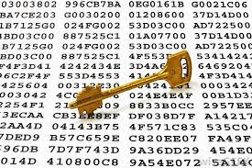
Efficient and robust partitioning
Partition your workload (Application) with
Reliable, proven Algorithm
No collisions
No corner cases

Slide 44

Latency of your application
Latency = Sum(L_{D}) + Sum(L_{S})
L_{D} = Device latency
L_{S} = Stupidity latency
Minimise stupidity

Slide 45

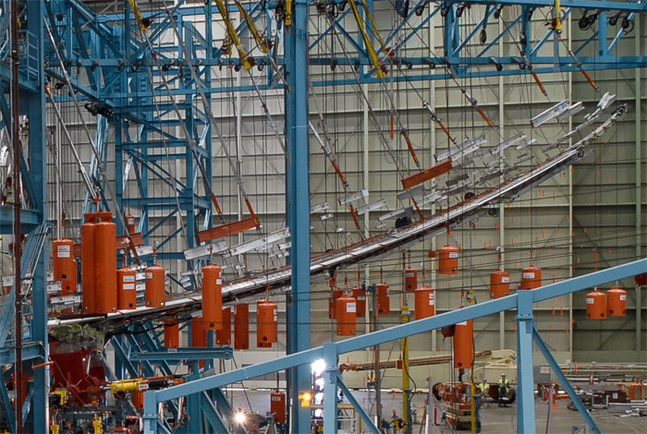
Load test
Simulation
Simulate real load
Nothing is better than real data
Record live data and playback in testing

Slide 46
Finally..
A well designed and build application should
Deliver the correct result
Perform adequately
Be maintainable by the average Guy or Girl

Slide 47

@aerospikedb
NEXT STEPS:
See how much you can save with Aerospike:
http://www.aerospike.com/tco-calculator/
Ready to get started?
http://www.aerospike.com/quick-start/
If you have any questions or want to further
explore if Aerospike is right for you, contact us:
info@aerospike.com
High Performance
NoSQL Database
Powering New
Opportunities at Scale

